Slide 1


Brownsville Elementary School
2013-14
“Home of the Buzzing Bees”
Creating Lifelong Learners

Slide 2
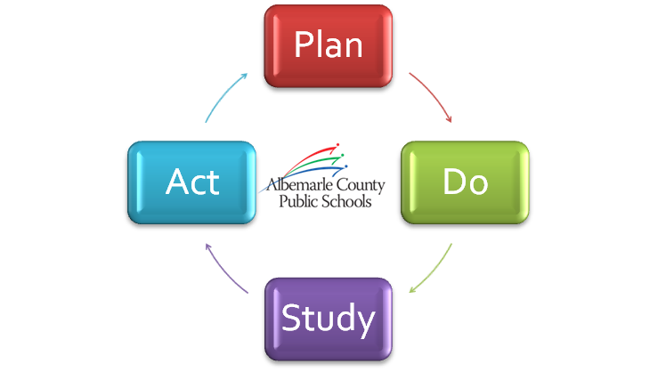
Albemarle County Public Schools
School Improvement Plan
2013 - 2014
KEY GOALS THIS YEAR
Goal 1: Increase student achievement in reading. Demonstrate consistent student achievement across all membership groups as measured through county benchmarks and state testing.
~~~~~~~~~~~~~~~~~~~~~~~~~~~~~~~~~~~~~
Goal 2: Brownsville Elementary School will build a caring community of learners. The Brownsville Community will promote respect, communicate clearly and guide students through social interactions.
~~~~~~~~~~~~~~~~~~~~~~~~~~~~~~~~~~~~~
Goal 3: The Brownsville Faculty will participate in professional development training to support best teaching practices that include implementation of technology and Responsive Classroom.

Slide 3

Why These Goals are Important
Brownsville Staff Strives for …
ALL learners to be fluent and comprehensive readers in all content areas.
ALL learners to experience a positive, inviting, and respectful learning community daily.
ALL learners to be able to adapt and apply a variety of strategies to solve increasingly complex problems.
All support the ACPS Strategic Plan

Slide 4
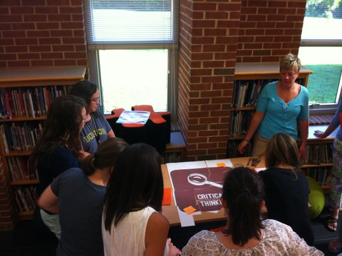
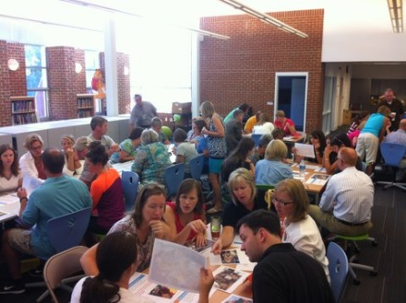
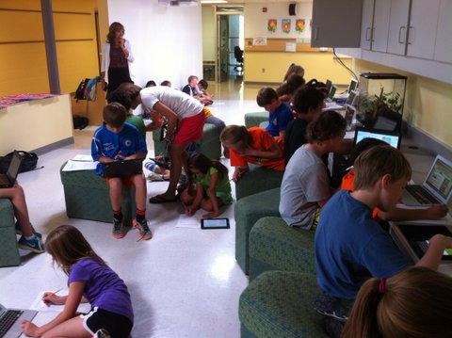
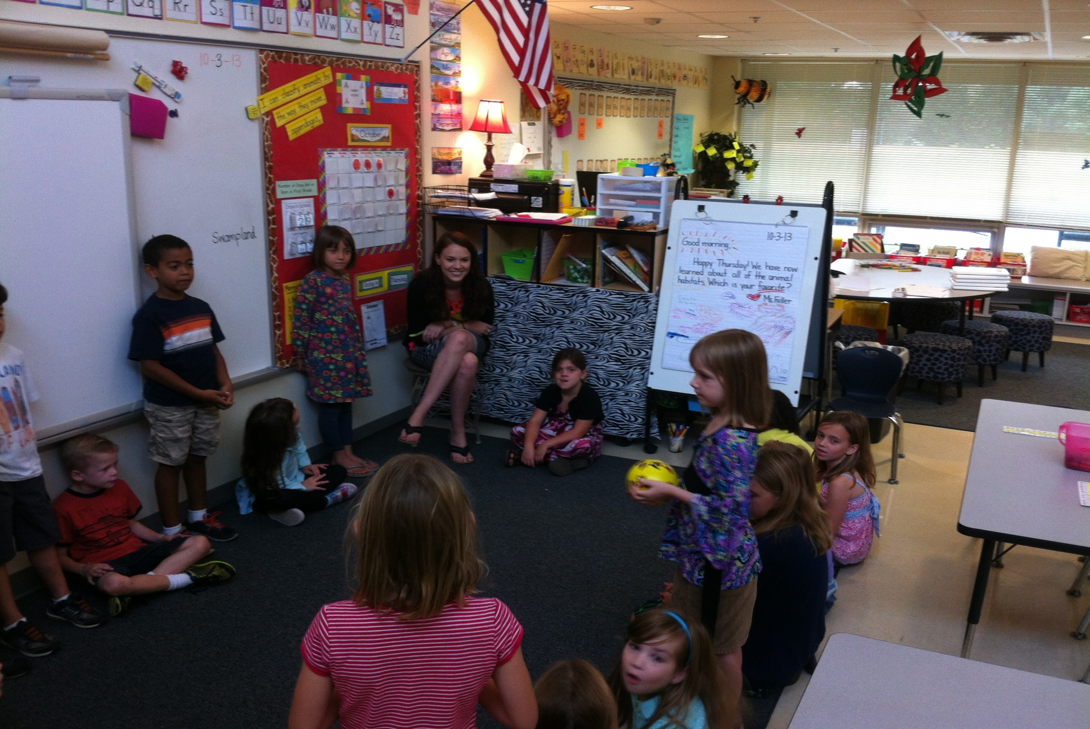

2013-2014 Initiatives
Current Challenges
Responsive Classroom Implementation
Technology Integration
Implementation of best instructional practices and performance assessments

Slide 5
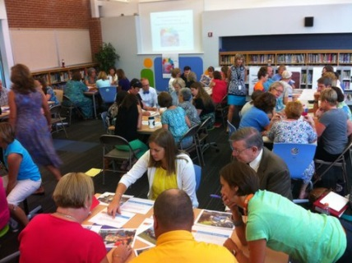
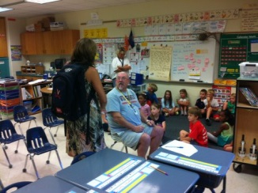
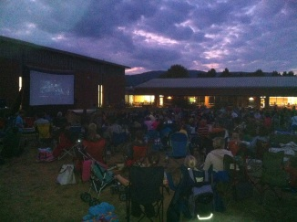
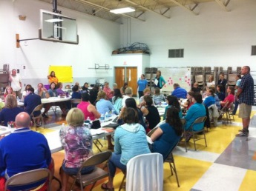
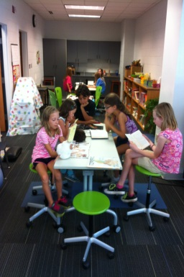
Current Successes
Aligned with Horizon 2020 Strategic Plan
Unleashing Each Student’s Potential
performance tasks
Design 2015
Library
Performance tasks
PTO events, BEE program, transportation

Slide 6
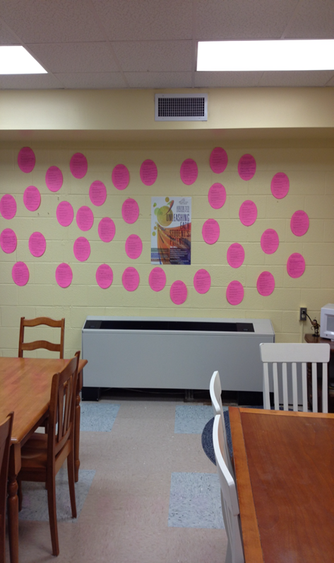
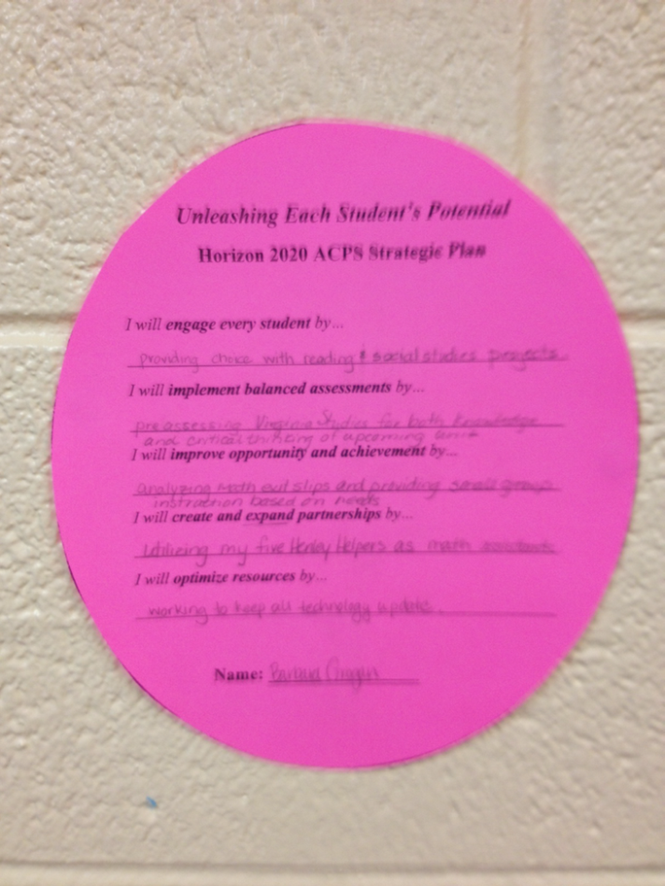
Introducing Horizon 2020
Strategic Wall
One Teacher’s Example for Unleashing Student Potential

